Slide 1
进展
1. 根据不同量表为为穿墙系统添加姿势。
2. 阅读一篇文章。

Slide 2
量表与动作
 | Berg | PASS | Tinetti Balance Test | Brunel Balance Assessment
无支撑坐 | √ | √ | √ | √
无支撑站 | √ | √ | √ | √
双脚并拢站立 | √
单脚站立(左、右) | √ | √（PASS为患侧、非患侧单脚站立） |  | √（BBA为交替踏阶梯）
双脚前后站立（左脚前、右脚前） | √ |  |  | √（BBA为健足在前患足在后）
站立情况下双上肢前伸 | √
坐情况下单臂完全上举(左、右) |  |  |  | √（BBA为举起健侧手臂）

Slide 3
How to build an embodiment lab: achieving body representation illusions in virtual reality
Frontiers in Robotics and AI (2014)

Slide 4
Introduction
1. For full immersion, visual, auditory, and haptic displays together with a tracking system are required.
2. We concentrate almost exclusively on HMD-based systems since these are the most appropriate for body ownership illusions (BOIs).
3. By “body ownership” we mean the illusory perception a person might have that an artiﬁcial body or body part is their own, and is the source of their sensations .
4. BOIs are used in body representation research, the most well known of which is the rubber hand illusion (RHI).

Slide 5
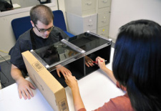

Slide 6
Introduction
5. VR has enabled the induction of a full body ownership illusions (FBOI) through the substitution in immersive VR of the participant’s body with a full virtual body seen from its own 1PP.
6. We discuss the technical infrastructure necessary for virtual embodiment experiments.
7. We intend this paper to help experimenters and application builders to carefully set up a VR system by highlighting beneﬁts and draw backs.

Slide 7
Material and Methods
1. Immersive VR systems that can be used to support BOIs
(1) Core virtual embodiment system
(2) Multimodal stimulation system
(3) Quantitative measurement system

Slide 8
Core virtual embodiment system
1. VR module: A VR scene consists of a set of 3D objects.
(1) Game engines: Unity3D, Unigine, Unreal, Ogre3D, Panda3D
(2) Graphics toolkits: OpenSceneGraph, OpenSG, OpenInventor, Irrlicht
(3) Virtual reality toolkits: XVR, VR Juggler, 3D Via Studio Pro, Vizard
(4) Important characteristics
(a) Extensibility
(b) Ease of tracking system integration
(c) Reliable workﬂow for loading 3D ﬁle formats
(d) Support for virtual mirrors, often used to enhance BOIs
(5) Our solution: XVR platform and the Unity game engine

Slide 9
Core virtual embodiment system
2. Head-tracking module: Tracking 3D head position and orientation.
(1) Optical systems (marker-based or markerless)
(a) Examples: Advanced Real-time Tracking (ART), NaturalPoint’sOptiTrack, PhaseSpace, Vicon
(b) They are not currently stable enough to be used for immersive VR head-tracking.
(2) Magnetic systems
(a) Example: Polhemus
(b) Anything that can generate a magnetic ﬁeld (e.g.,mobile phones,etc.) can interfere with the signals sent to the sensors.
(3) Acoustic systems: Emit and sense ultrasonic sound waves.
(a) Sound travels relatively slowly, so the update rate of the participant’s position and orientation is also slow.
(b) The speed of sound through air can change depending on temperature, humidity, or barometric pressure.

Slide 10
Core virtual embodiment system
2. Head-tracking module: Tracking 3D head position and orientation.
(4) Inertial systems: Small gyroscopes.
(a) Fast and accurate.
(b) Their main disadvantage is the drift between actual and reported values that is accumulated over time.
(5) Mechanical systems: A direct mechanical connection to the target.
(a) Participant motion is constrained by the reach of the mechanical systems.
(6) Important characteristics
(a) Stability
(b) Latency
(c) Precision

Slide 11
Core virtual embodiment system
2. Head-tracking module: Tracking 3D head position and orientation.
(7) Our solution: IS-900 tracker (a hybrid acoustic/inertial system)
(a) Low latency (around 4ms)
(b) A precision of 0.75mm and 0.05°
3. Display module: Displaying the VE to the participant.
(1) Computer screens, powerwalls, and HMDs
(2) Important characteristics
(a) Resolution
(b) FOV
(c) Weight (A 2-kg load would induce fatigue after only 2min.)
(2) Our solution: NVIS nVisor SX111 (1.3kg)

Slide 12
Multimodal stimulation system
1. Full body motion capture module: This module is used to capture the motion of the body .
(1) Marker-based optical systems
(a) Examples: OptiTrack ARENA system from NaturalPoint, ART, PhaseSpace, and Vicon
(b) Participant must wear a suit with reﬂective or active (using LEDs at speciﬁc frequencies) markers.
(2) Markerless optical systems
(a) Example: Organic Motion, Kinect
(b) It is not possible to track the user from a side view or in a seated position without severe tracking issues.
(c) More complex postures are not possible to track

Slide 13
Multimodal stimulation system
1. Full body motion capture module: This module is used to capture the motion of the body .
(3) Inertial systems
(a) Examples: MVN of Xsens, IGS of Animazoo
(b) Tracking can be performed both indoors and outdoors since no cameras are required.
(c) Positional and rotational drift.
(4) Mechanical systems: Using an exoskeleton worn by the participant.
(a) Example: Gypsy7 from MetaMotion
(b) Participant must wear a cumbersome and heavy device.
(5) Magnetic systems: Participant wears a body suit to which the electromagnetic trackers are attached.
(a) Example: Polhemus

Slide 14
Multimodal stimulation system
1. Full body motion capture module: This module is used to capture the motion of the body .
(6) Important characteristics
(a) Latency
(b) Precision
(c) Occlusions (In order not to restrain the participant’s movements.)
(7) Our solution:
(a) Optical and inertial full body motion tracking systems.
(b) Head-tracking was far more robust and stable when using a separate head-tracker instead of relying on the full body tracking software to provide head movements.

Slide 15
Multimodal stimulation system
2. Haptics module: Providing the tactile stimuli.
(1) Active force-feedback devices
(a) Examples: Phantom, CyberGlove
(2) Low frequency audio
(a) They can provide a means of collision response if higher quality haptics is not available.
(3) Temperature transducers
(4) Pressure: Air-pocket jackets (e.g., TN Games Tactile gaming vest)
(5) Passive haptics: Static surfaces that mimic the haptic and geometric properties.
(6) Vibro-tactile

Slide 16
Multimodal stimulation system
2. Haptics module: Providing the tactile stimuli.
(7) Important characteristics
(a) Application
(b) Safety
(c) Ergonomics(人体工程学)
(8) Our solution
(a) Vibro-tactile system (Velcro jacket)

Slide 17
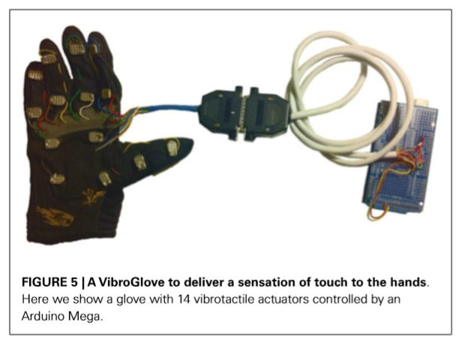

Slide 18
Quantitative measurement system
1. Physiological measurement module
(1) Biosignal ampliﬁers and sensors
(a) Examples: g.tec, Thought Technology, Mind Media, Biopac Systems, and TMSI
(b) Typical limitations include lack of support for TCP/UDP and low sample rate.
(2) Software: APIs/SDKs for C++, Java, and/or MATLAB.
(3) Important characteristics
(a) Flexibility
(b) Capabilities
(c) Extensibility
(d) Ease of integration with the VR module: network communication, programing interfaces (API,SDK).
(4) Our solution
(a) gUSBamp, gMOBIlab, Nexus-4, and Enobio (MATLAB Simulink)

Slide 19
Quantitative measurement system
2. EEG module
(1) The EEG module provides an objective way to measure real responses to virtual stimuli.
(2) Important characteristics
(a) Number of channels supported
(b) Real-time capabilities
(c) Communication support
(d) Ease of integration with the VR module
(3) Our solution
(a) g.tec g.USBAmp for recording up to 32 EEG channels.
(b) g.tec g.Mobilab (Bluetooth)

Slide 20
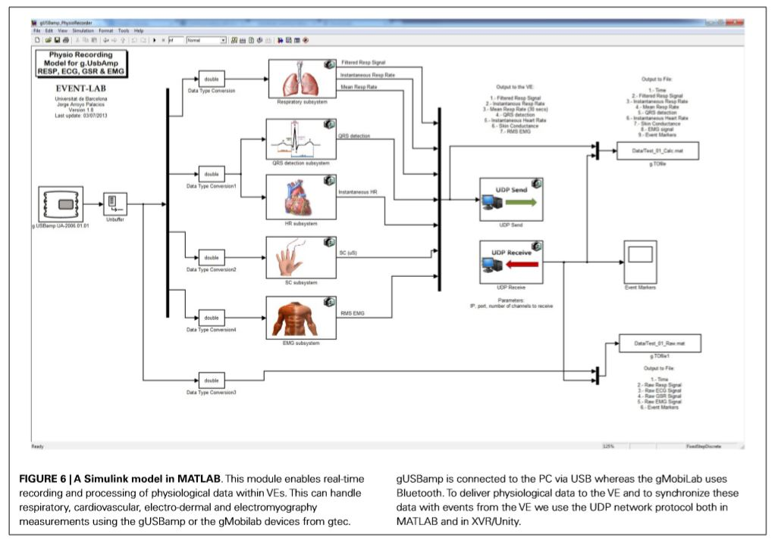

Slide 21
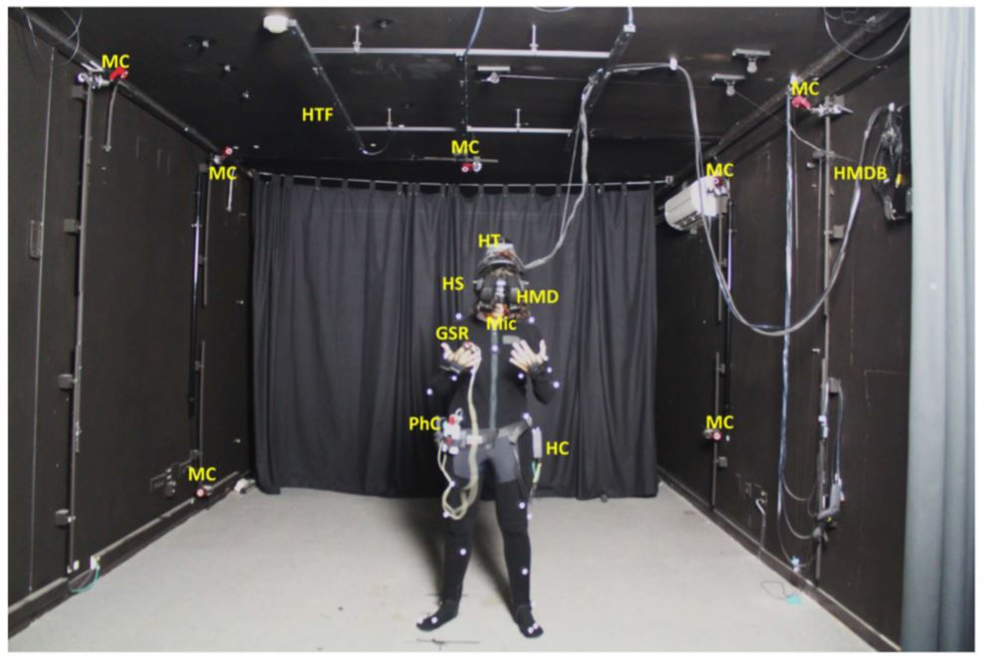

Slide 22
Results and Discussion
1. The design and implementation of a system capable of creating complex VEs, delivering multimodal stimulations as well as measuring the effect of the illusions induced on the participants has to be carefully considered.
2. We advocate a modular system architecture that enables the inclusion of various techniques for multimodal stimulation and physiological measurements.

